Slide 1
Deals Website
Team Name: Seekers
Amulya kasaraneni
Sandeep Nukala
Hemasree Koganti
sai Priyanka gurajada

Slide 2
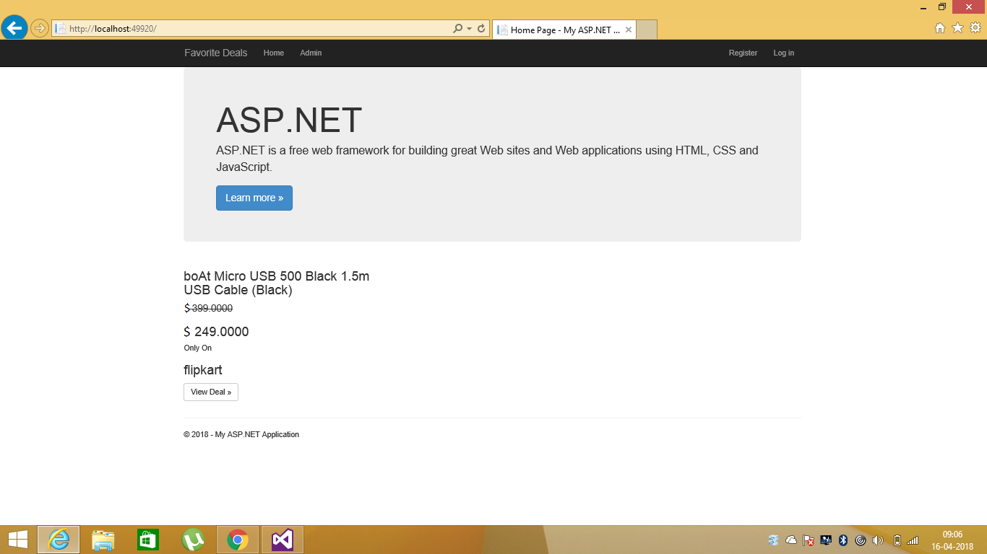
Home Page

Slide 3
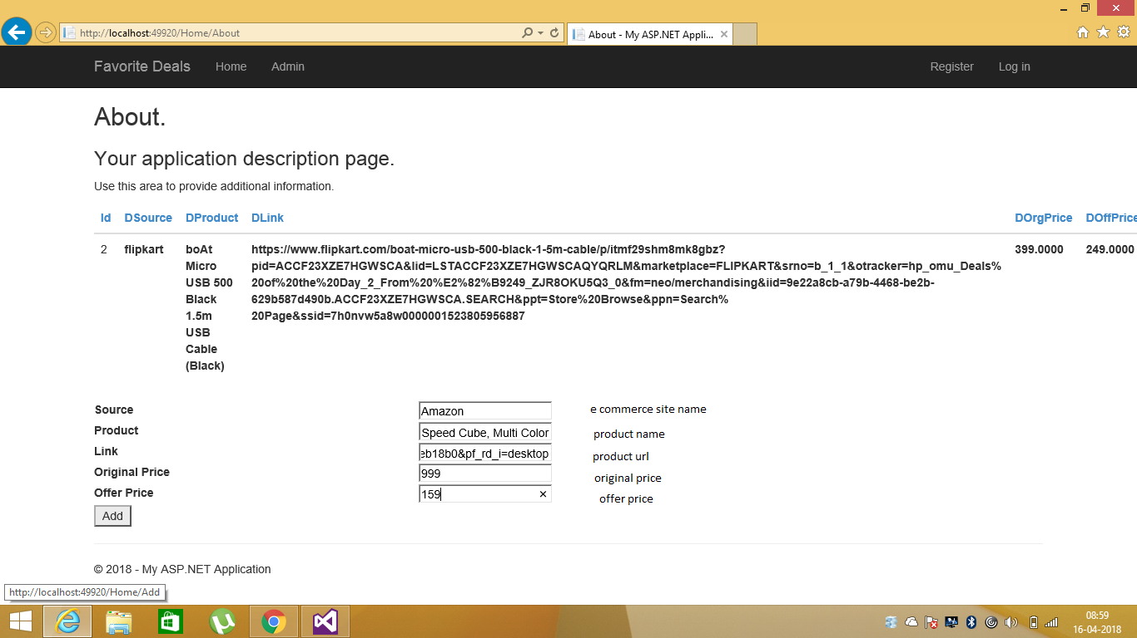
Favorite deals

Slide 4
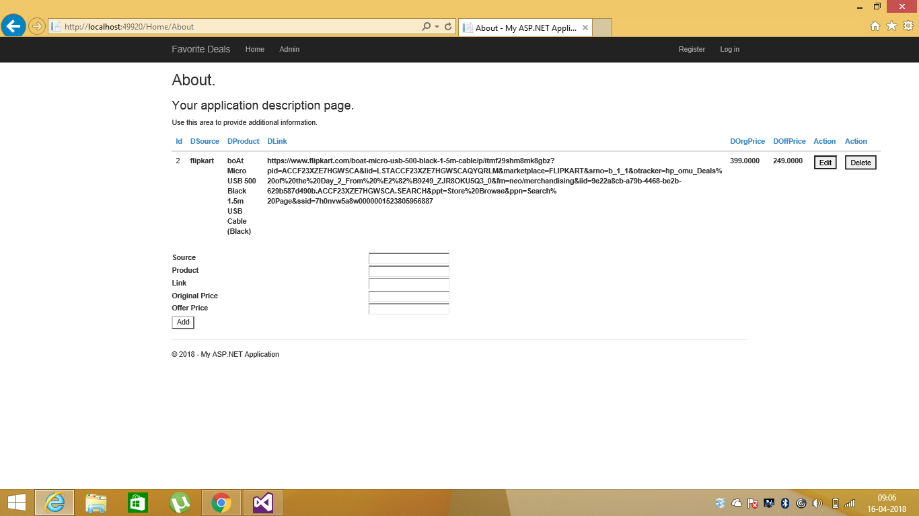
Admin

